Slide 1
Rice Data Science Bootcamp
Instructor: Natalie Berestovsky, PhD
Anadarko Petroleum
08/14/2019
Rice Data Science Bootcamp 2019
<number>
Notes:
<number>

Slide 2
Supervised vs unsupervised
 | Supervised | Unsupervised
Discrete | Classification | Clustering
 | KNN Datasets: Wine dataset | K-Means Hierarchical clustering (Biclustering) Datasets: Synthetic data NCI60
Continuous | Regression | Dimensionality reduction
 | Multilinear regression Ridge regression Lasso regression Datasets: Boston housing dataset Synthetic data | Principle Component Analysis (PCA) Datasets: Art data NCI60
08/14/2019
Rice Data Science Bootcamp 2019
<number>
Notes:
https://idyll.pub/post/dimensionality-reduction-293e465c2a3443e8941b016d/
<number>

Slide 3
Schedule
8:00- 10.00 - Intro & Dimension Reduction 10:00 - 10:30 - Break 10:30 - 11:15 - Dimension Reduction contd. 11:15 - 12:00 - Intro to Graphical Models 12:00 - 1:15 - Lunch
1:15 - 2:30 - Clustering 2:30 - 2:45 - Break 2:45 - 3:45 - Clustering contd. 3:45 - 4:00 - Break 4:00 - 5:00 - Unsupervised Learning Lab
08/14/2019
Rice Data Science Bootcamp 2019
<number>

Slide 4
Unsupervised learning best practices
No “true” (response) data
Exploratory analysis
Data driven discoveries
Hypothesis generating
Show a data driven discovery is stable
Small changes in data, algorithm, parameter yield similar results
Multiple approaches yield the similar results
Corroborate via existing knowledge / literature
08/14/2019
Rice Data Science Bootcamp 2019
<number>
Notes:
<number>

Slide 5
Clustering
08/14/2019
Rice Data Science Bootcamp 2019
<number>

Slide 6
Clustering
08/14/2019
Rice Data Science Bootcamp 2019
<number>

Slide 7
K Means
Objective: minimize within cluster dissimilarity W(C)
Using squared Euclidean distance
n observations, K clusters
Initialize clusters OR centroids randomly
08/14/2019
Rice Data Science Bootcamp 2019
<number>

Slide 8
K Means
Highly dependent on initialization
Local solution
Good for compact spherical clusters
08/14/2019
Rice Data Science Bootcamp 2019
<number>
Notes:
Right hand side shows different inti
<number>

Slide 9
Choosing K
Elbow method
08/14/2019
Rice Data Science Bootcamp 2019
<number>

Slide 10
Hierarchical clustering
08/14/2019
Rice Data Science Bootcamp 2019
<number>

Slide 11
Hierarchical clustering
Leaf for each observation.
As we move up the tree, similar leaves begin to fuse into branches
Observations that fuse near the top of the tree, can be quite different.
The lower in the tree fusions occur, the more similar the groups of observations are to each other.
Height of fusions indicate how similar objects are.
Horizontal axis does not indicate anything
08/14/2019
Rice Data Science Bootcamp 2019
<number>

Slide 12
Agglomerative Clustering
Begin with every observation representing a singleton cluster.
At each step, merge two “closest” clusters into one cluster and reduce the number of clusters by one.
Need a measure of dissimilarity between two clusters - called linkages.
08/14/2019
Rice Data Science Bootcamp 2019
<number>

Slide 13
Linkage
Single linkage
the distance between two clusters is defined as the shortest distance between two points in each cluster
Complete linkage
the distance between two clusters is defined as the longest distance between two points in each cluster
Average linkage
the distance between two clusters is defined as the average distance between each point in one cluster to every point in the other cluster
08/14/2019
Rice Data Science Bootcamp 2019
<number>

Slide 14
Linkage
08/14/2019
Rice Data Science Bootcamp 2019
<number>

Slide 15
Linkage examples
Complete linkage often gives comparable cluster sizes
Single linkage is sensitive to outliers
08/14/2019
Rice Data Science Bootcamp 2019
<number>

Slide 16
Bi-clustering
Find groups of BOTH observations & features.
Clustering both rows and columns of data matrix.
Applications in Omics data
08/14/2019
Rice Data Science Bootcamp 2019
<number>

Slide 17
Supervised vs unsupervised
 | Supervised | Unsupervised
Discrete | Classification | Clustering
 | KNN Datasets: Wine dataset | K-Means Hierarchical clustering (Biclustering) Datasets: Synthetic data NCI60
Continuous | Regression | Dimensionality reduction
 | Multilinear regression Ridge regression Lasso regression Datasets: Boston housing dataset Synthetic data | Principle Component Analysis (PCA) Datasets: Art data NCI60
08/14/2019
Rice Data Science Bootcamp 2019
<number>
Notes:
https://idyll.pub/post/dimensionality-reduction-293e465c2a3443e8941b016d/
<number>

Slide 18
Dimensionality reduction
For Big-Data:
Data visualization difficult!
High degrees of redundancy
Many features may be uninformative.
Dimension Reduction Idea:
Map data into lower-dimensional space that retains important information.
08/14/2019
Rice Data Science Bootcamp 2019
<number>

Slide 19
Principle Component Analysis (PCA)
Data matrix: X_{n×p}, n observations and p features.
Find low-dimensional representations that capture most of the variation in the data.
08/14/2019
Rice Data Science Bootcamp 2019
<number>

Slide 20
PCA
What is a good 1D representation for this data?
08/14/2019
Rice Data Science Bootcamp 2019
<number>

Slide 21
PCA
Find line that maximizes the variance of the data projected onto the line
Subsequent components orthogonal (perpendicular).
08/14/2019
Rice Data Science Bootcamp 2019
<number>

Slide 22
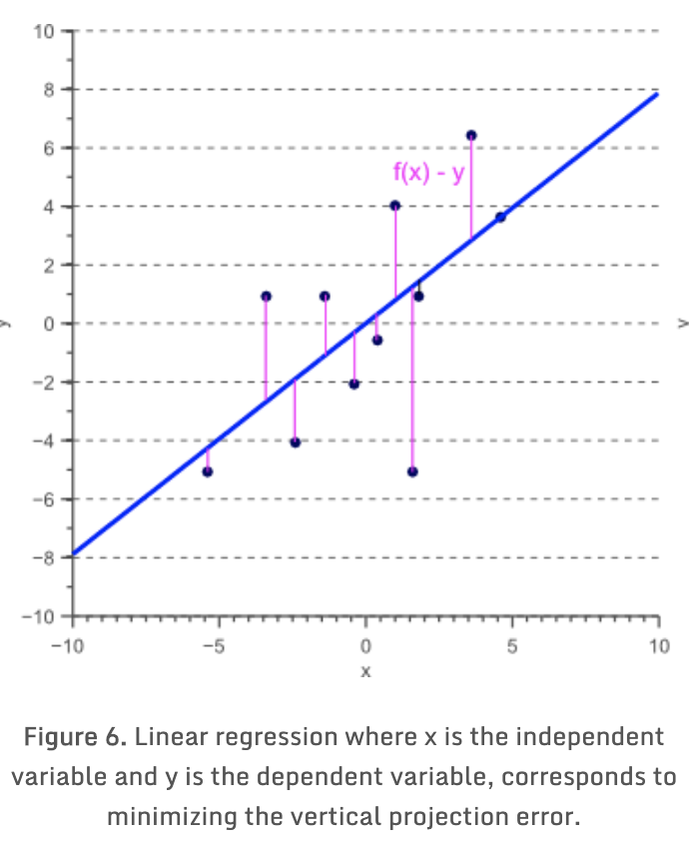
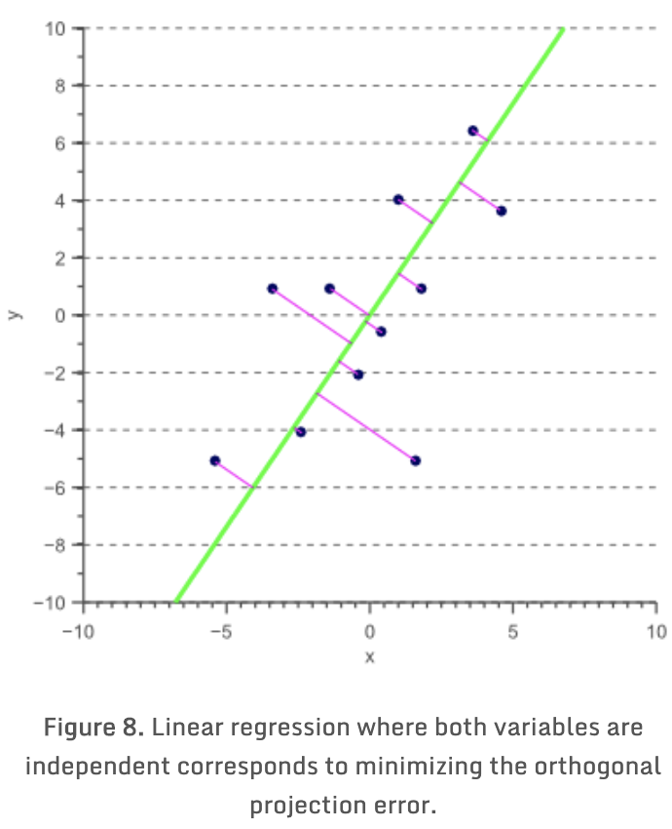
PCA main idea
PCA minimizes orthogonal projection onto line: z = v₁ x₁ +v₂ x₂.
Note: Not same as OLS (ordinary least squares) which minimizes projection of y onto x!
08/14/2019
Rice Data Science Bootcamp 2019
<number>
Notes:
https://www.visiondummy.com/2014/05/feature-extraction-using-pca/
<number>

Slide 23

PCA components
The first principal component accounts for the largest possible variance in the data set
The second principal component is calculated in the same way, with the condition that it is uncorrelated with (i.e., perpendicular to) the first principal component and that it accounts for the next highest variance.
This continues until a total of p principal components have been calculated, equal to the original number of variables.
08/14/2019
Rice Data Science Bootcamp 2019
<number>

Slide 24
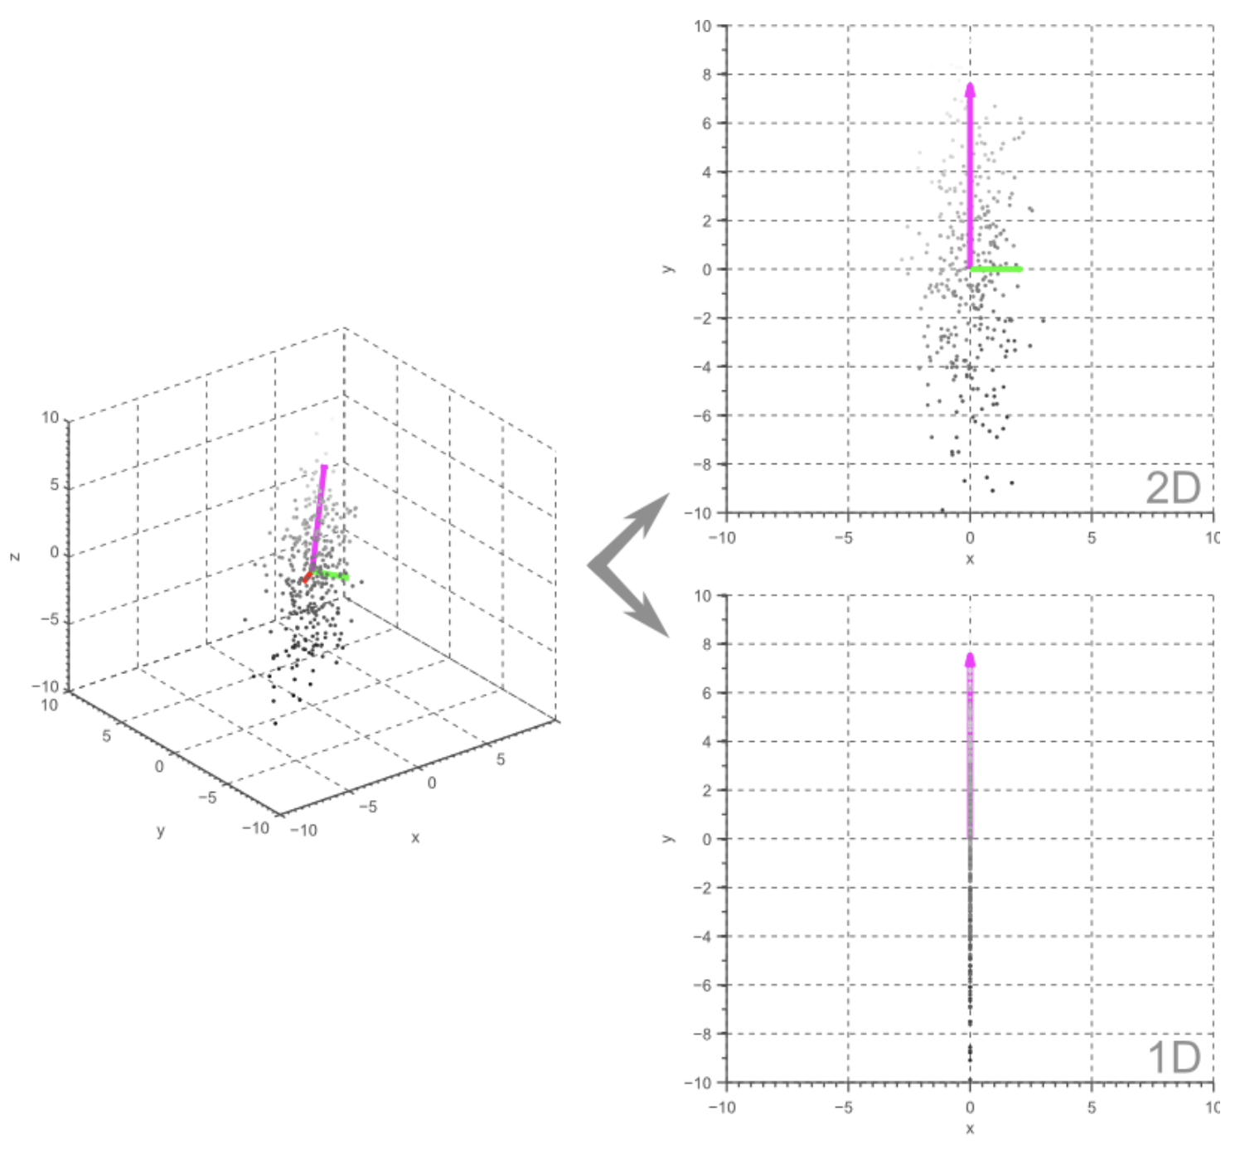
PCA visualization
08/14/2019
Rice Data Science Bootcamp 2019
<number>

Slide 25
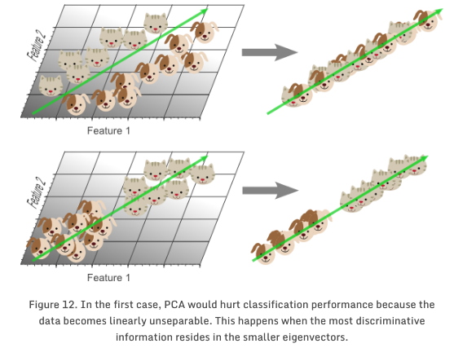
PCA drawbacks
Linear projections!
08/14/2019
Rice Data Science Bootcamp 2019
<number>
Notes:
The crowding problem basically comes from the curse of dimensionality. In high dimensional space, the surface of a sphere grows much more quickly with its radius compared to a sphere in low dimensional space (search “curse of dimensionality” for more details). This means that high-dimensional spaces can have many points at a medium distance from a certain point.
<number>

Slide 26
t-SNE
t-Distributed Stochastic Neighbor Embedding
Laurens van der Maaten, 2008
Step 1: In the high-dimensional space, create a probability distribution that dictates the relationships between various neighboring points
Step 2: It then tries to recreate a low dimensional space that follows that probability distribution as best as possible.
The “t” in t-SNE comes from the t-distribution, which is the distribution used in Step 2. The “S” and “N” (“stochastic” and “neighbor”) come from the fact that it uses a probability distribution across neighboring points.
08/14/2019
Rice Data Science Bootcamp 2019
<number>
Notes:
https://mlexplained.com/2018/09/14/paper-dissected-visualizing-data-using-t-sne-explained/
<number>

Slide 27
Links
https://idyll.pub/post/dimensionality-reduction-293e465c2a3443e8941b016d/
08/14/2019
Rice Data Science Bootcamp 2019
<number>

